Slide 1

Ransomware Attacks in Distributed Systems
Team S.A.A.S

Slide 2




Introduction
The attacker software asks the users to pay a ransom amount for providing a decryption key for regaining access to the system and its files
A report by Kaspersky suggests that 34 percent of businesses hit with ransomware took a week or more to regain access to their data.
Ransomware was the number one attack type observed by X-Force last year, decreasing to 21% of attacks from 23% in the previous year.

Slide 3
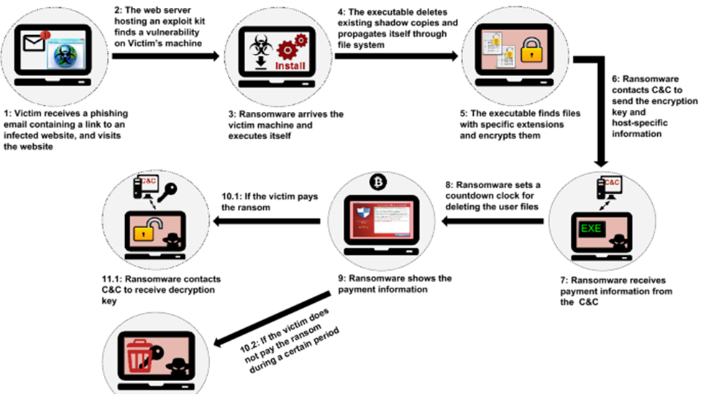
ANATOMY OF ATTACK

Slide 4

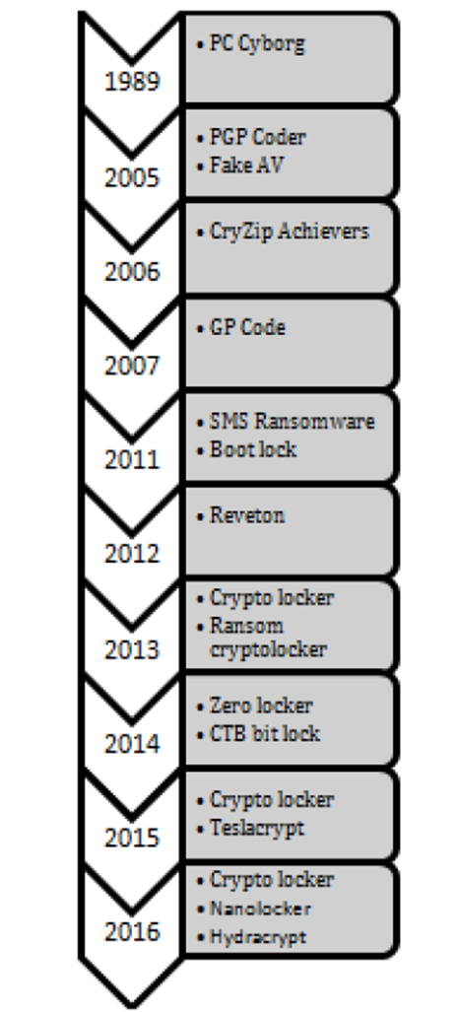
COMMON RANSOMWARE ATTACKS

Slide 5
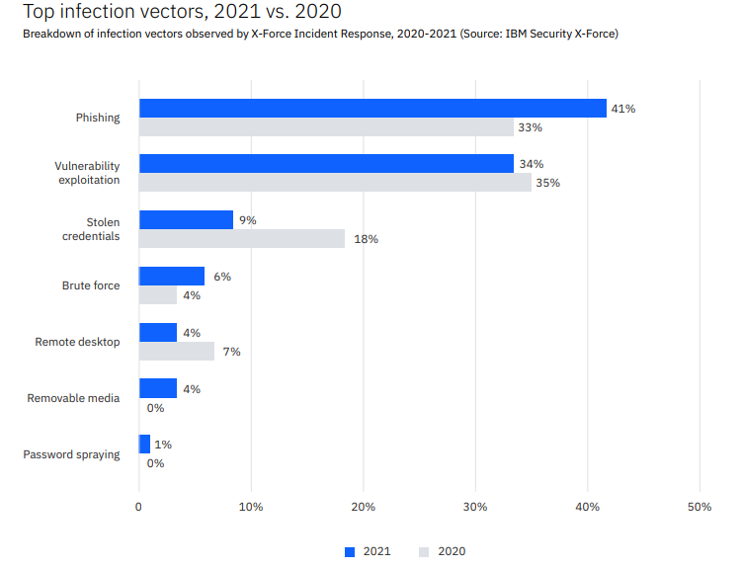
TOP ATTACK MODES OVERTIME

Slide 6
INCIDENT RESPONSE CYCLE (NIST)
PREPARATION
DETECTION & ANALYSIS
ERADICATION
POST INCIDENT ACTIVITIES
Providing Role Based User Education
Running simulations to report
Refreshing Credentials and avoiding default password practices
Detect the infected systems
Isolate systems from the network
Use End Point Detection programs to find bugs and vulnerabilities.
Use trusted templates and Root cause analysis to find what attacks are present.
If a decryption was discovered by experts, apply.
Flush out the systems entirely and apply new firewalls throughout the network bubble.
Connect back the systems only after fixing the exploits.
Block and monitor the source of attacks
Make a clear report of the incident occurred.
Bring online the cold storage backup.
Use security automation so the incident is learned by the system and further similar experiences are all blocked.

Slide 7
Recommended Strategies
ZERO TRUST ASSIST (Microsoft & ibm)
Advanced email security (cisco)
RBAC – Role BASED access management
Using MFA for all devices
Use Single Sign On when possible
Logs and inspects all corporate network traffic
Limits and controls access to the network
Verifies and secures network resources
Use firewalls with learning-based techniques
Avoid script embedded attachments
Disable Flash and Macros
Educate upon unknown encrypted extensions [.micro (teslacrypt3.0), .zepto (Locky), .cerber3, .axx)
Use Lease Privilege First method
Apply digital transformation ( move to secure clouds from legacy systems like Active Directory )

Slide 8
REFERENCES
[1] Mike Chapple, CISSP: Cert Prep (2021): 3 Security Architecture and Engineering. (Feb. 2022), Ransomware. Accessed: Jul. 7, 2022. [Streaming video]. Available: LinkedIn Learning database.
[2] Ransomware Defense For Dummies®, Cisco 2nd Special Edition
[3] IBM Security X-Force Threat Intelligence Index 2022 Full Report
[4] Dargahi, T., Dehghantanha, A., Bahrami, P.N. et al. A Cyber-Kill-Chain based taxonomy of crypto- ransomware features. J Comput Virol Hack Tech 15, 277–305 (2019). https://doi.org/10.1007/s11416-019-00338-7
[5]https://www.ibm.com/topics/zero-trust
TEAM
Sreeja Atluri
Arshil Riaz
Abhishek Kesiraju
Saurab Gour

Slide 9


Thank You

